Slide 1
Chapter 14
Building Multithreaded Applications

Slide 2
Objectives
How to build multithreaded applications
How to keep shared resources thread-safe

Slide 3
Content
The Process/AppDomain/Context/Thread relationship
The System.Threading namespace
The System.Threading.Thread class
Lifecycle of a Thread
Programmatically creating secondary threads
The issue of concurrency
Programming with Timer Callbacks.
Understanding the CLR ThreadPool

Slide 4
The Process/AppDomain/Context/Thread relationship
A thread was defined as a path of execution within an executable application
By implementing additional threads, you can build more responsive (but not necessarily faster executing) applications
Under the .NET platform, there is not a direct one-to-one correspondence between application domains and threads

Slide 5
The Process/AppDomain/Context/Thread relationship
A given AppDomain can have numerous threads executing within it at any given time
Threads are free to cross application domain boundaries as the Win32 thread scheduler and CLR see fit
A given thread can execute within only a single application domain at any point in time

Slide 6
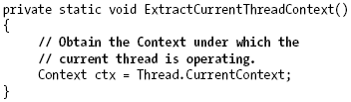
The Process/AppDomain/Context/Thread relationship
A single thread may also be moved into a particular context at any given time, and it may be relocated within a new context at the whim of the CLR.

Slide 7
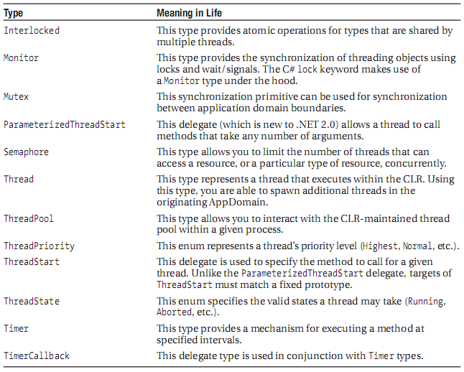
The System.Threading namespace
MSDN

Slide 8
The System.Threading.Thread class
Defines a number of methods that allow to create new threads, as well as to suspend, stop, and destroy a particular thread
A thread's priority level offers a hint to the CLR regarding the importance of the thread's activity
A thread with the value ThreadPriority.Highest is not necessarily guaranteed to given the highest precedence

Slide 9
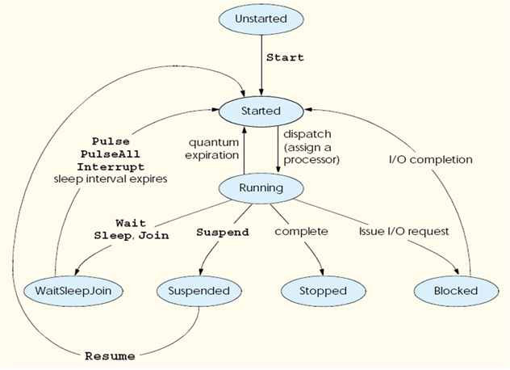
Lifecycle of a Thread

Slide 10
Programmatically creating secondary threads
Create a type method to be the entry point for the new thread
Create a new ParameterizedThreadStart (or legacy ThreadStart) delegate, passing the address of the method defined in step 1 to the constructor
Create a Thread object, passing the ParameterizedThreadStart/ThreadStart delegate as a constructor argument
Establish any initial thread characteristics (name, priority, etc.)
Call the Thread.Start() method. This starts the thread at the method referenced by the delegate created in step 2 as soon as possible

Slide 11
Programmatically creating secondary threads
Foreground threads and Background threads
  Foreground threads have the ability to prevent the current application from terminating
    The CLR will not shut down an application until all foreground threads have ended.
  Background threads (sometimes called daemon threads) are viewed by the CLR as expendable paths of execution that can be ignored at any point in time (even if they are currently laboring over some unit of work)
    if all foreground threads have terminated, any and all background threads are automatically killed when the application domain unloads

Slide 12
The issue of concurrency
Happen if multiple threads were accessing the same point of data
Way to programmatically enforce synchronized access to the shared resources
  Using the C# lock keyword
  Using the System.Threading.Monitoring type
  Using the System.Threading.Interlocked type
  Using the [Synchronization] type

Slide 13
The issue of concurrency
Synchronization using the System.Threading.Monitor type
  are able to instruct the active thread to wait for some duration of time
  inform waiting threads when the current thread is completed

Slide 14
Programming with Timer Callbacks
Many applications have the need to call a specific method during regular intervals of time:
  display the current time on a status bar via a given helper function
  perform noncritical background tasks such as checking for new e-mail messages
Use the System.Threading.Timer type in conjunction with a related delegate named TimerCallback.

Slide 15
Understanding the CLR ThreadPool
When method is invoked asynchronously using delegate types (via the BeginInvoke() method), the CLR does not literally create a brand-new thread
For purposes of efficiency, a delegate’s BeginInvoke() method leverages a pool of worker threads that is maintained by the runtime
The System.Threading namespace provides the ThreadPool class type to interact with this pool of waiting threads
ThreadPool.QueueUserWorkItem() method
Notes:
Queues a method for execution, and specifies an object containing data to be used by the method

Slide 16
Understanding the CLR ThreadPool
Advantages
  The thread pool manages threads efficiently by minimizing the number of threads that must be created, started, and stopped
  By using the thread pool, can focus on your business problem rather than the application’s threading infrastructure
Disadvantages
  Pooled threads are always background threads with default priority (ThreadPriority.Normal)
  Cannot abort it, suspend it, or discover it by name

Slide 17
Summary
Examining how .NET delegate types can be configured to execute a method in an asynchronous manner.
Role of the System.Threading namespace.
Examining several manners to protect thread-sensitive blocks of code.
Internal pool of threads

Slide 18
Q & A

